Slide 1

Project Title
M.SAI SREE (2210030045)
Under the esteemed guidance of
Ms. P. Sree Lakshmi
Assistant Professor,
Department of Computer Science and Engineering

Slide 2
Project Overview
The Serverless Blog Engine is a fully serverless application built using AWS services, designed to deliver a scalable and cost-effective platform for blogging without the need to manage servers or infrastructure. The blog's frontend is hosted on Amazon S3, which serves static files such as HTML, CSS, JavaScript, and media content. Blog post data is stored in Amazon DynamoDB, a fast and flexible NoSQL database that allows for efficient storage and retrieval of structured data. AWS Lambda functions are used to handle the backend logic, including Create, Read, Update, and Delete (CRUD) operations for blog posts. These functions are triggered via Amazon API Gateway, which provides secure and scalable RESTful endpoints to interact with the frontend. IAM roles and policies are used to manage permissions and ensure secure interactions between services. This architecture not only simplifies deployment and scaling but also ensures low operational overhead, making it an ideal solution for modern web applications with dynamic content requirements.

Slide 3
Services Used
The Serverless Blog Engine leverages a suite of AWS services to achieve a fully managed, scalable, and cost-efficient architecture.
Amazon S3 is used to host the static frontend of the blog, including HTML, CSS, JavaScript, and media assets, providing high availability and fast content delivery.
Amazon DynamoDB acts as the primary NoSQL database for storing blog post metadata and content, enabling quick and seamless read/write operations.
AWS Lambda handles the backend logic, executing CRUD operations in response to HTTP requests without provisioning or managing servers. These Lambda functions are exposed via
Amazon API Gateway, which facilitates secure and scalable RESTful APIs to connect the frontend with the backend services.
IAM (Identity and Access Management) ensures secure access control between the services through fine-grained permissions. Together, these services form a robust serverless stack that eliminates infrastructure concerns while offering strong performance and reliability.

Slide 4
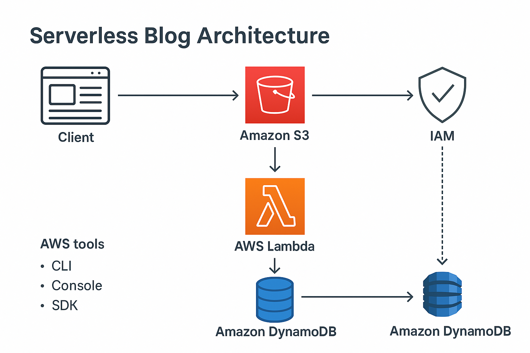
Flow Diagram

Slide 5
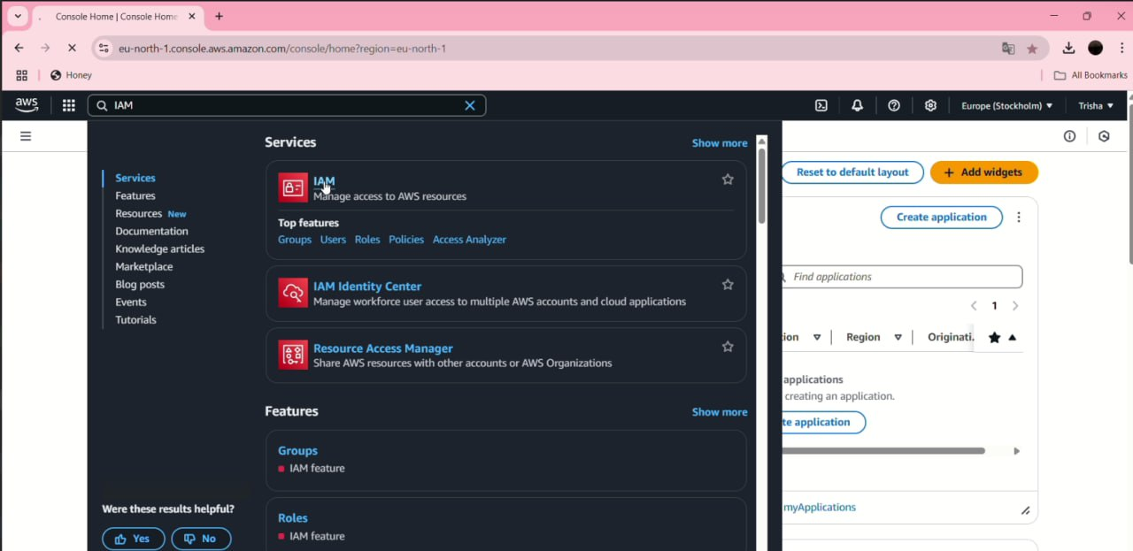
Implementation Process
Step 1: NAVIGATE TO IAM

Slide 6
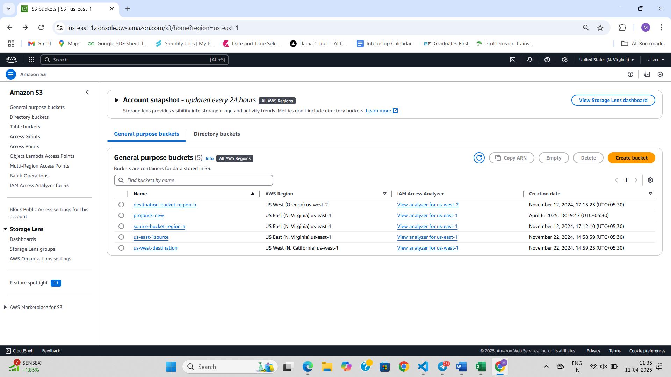
Step 2:create s3 bucket

Slide 7
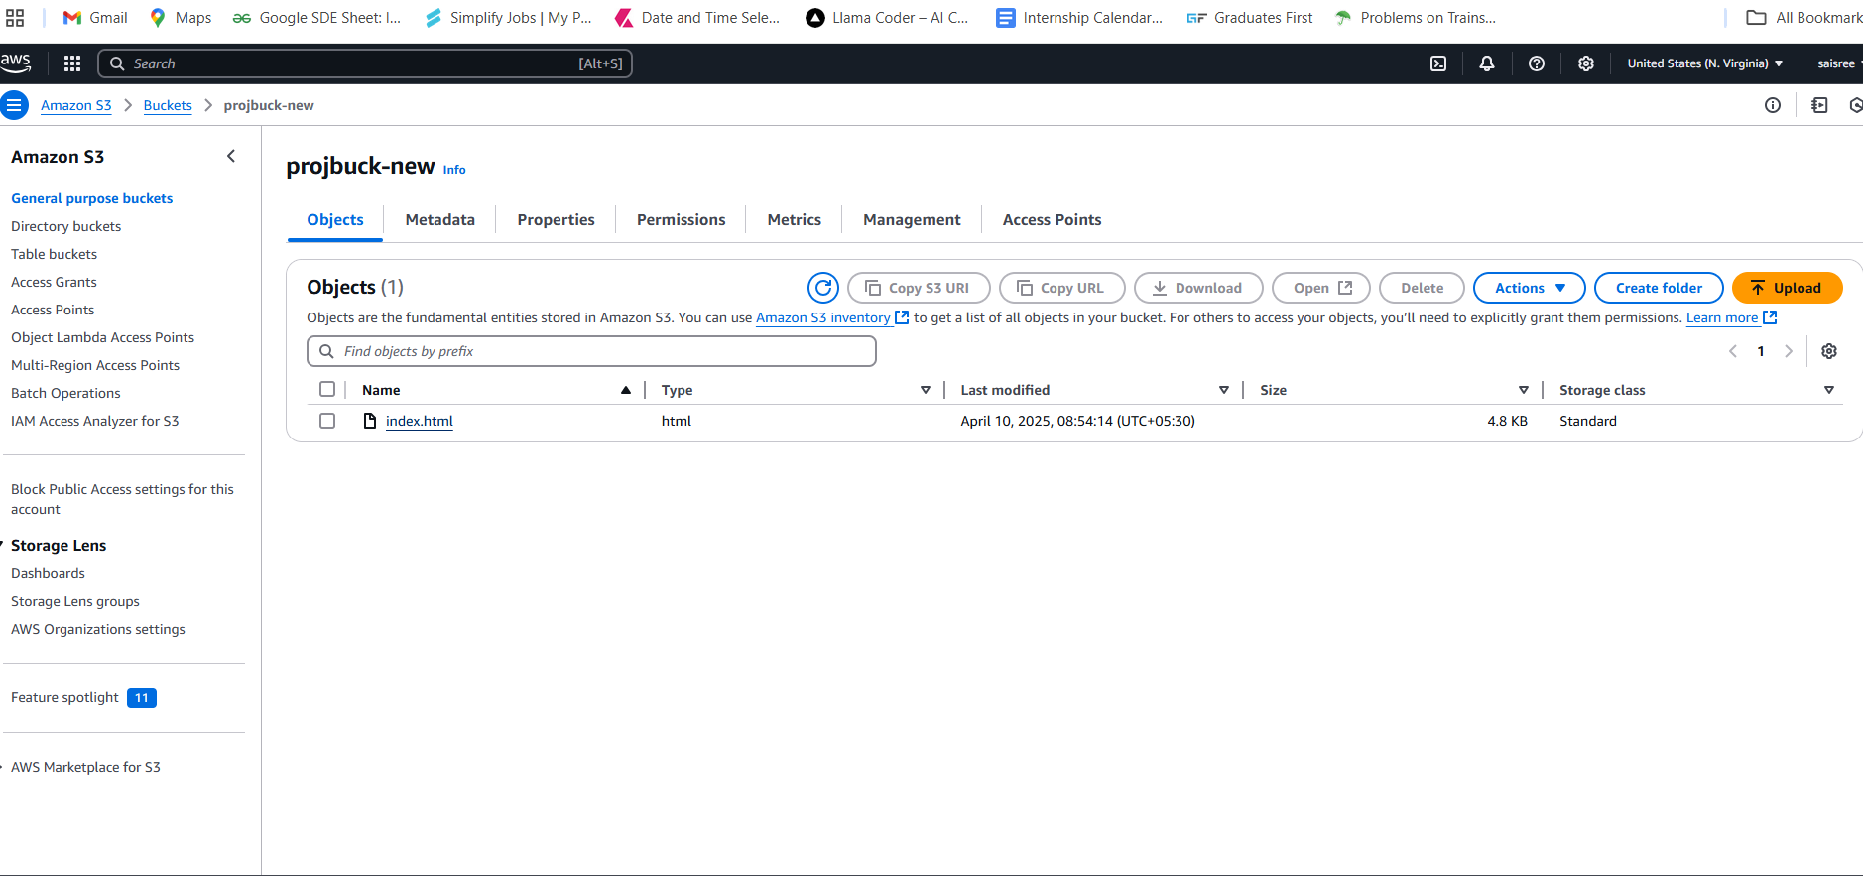
Step 3: upload file into s3

Slide 8
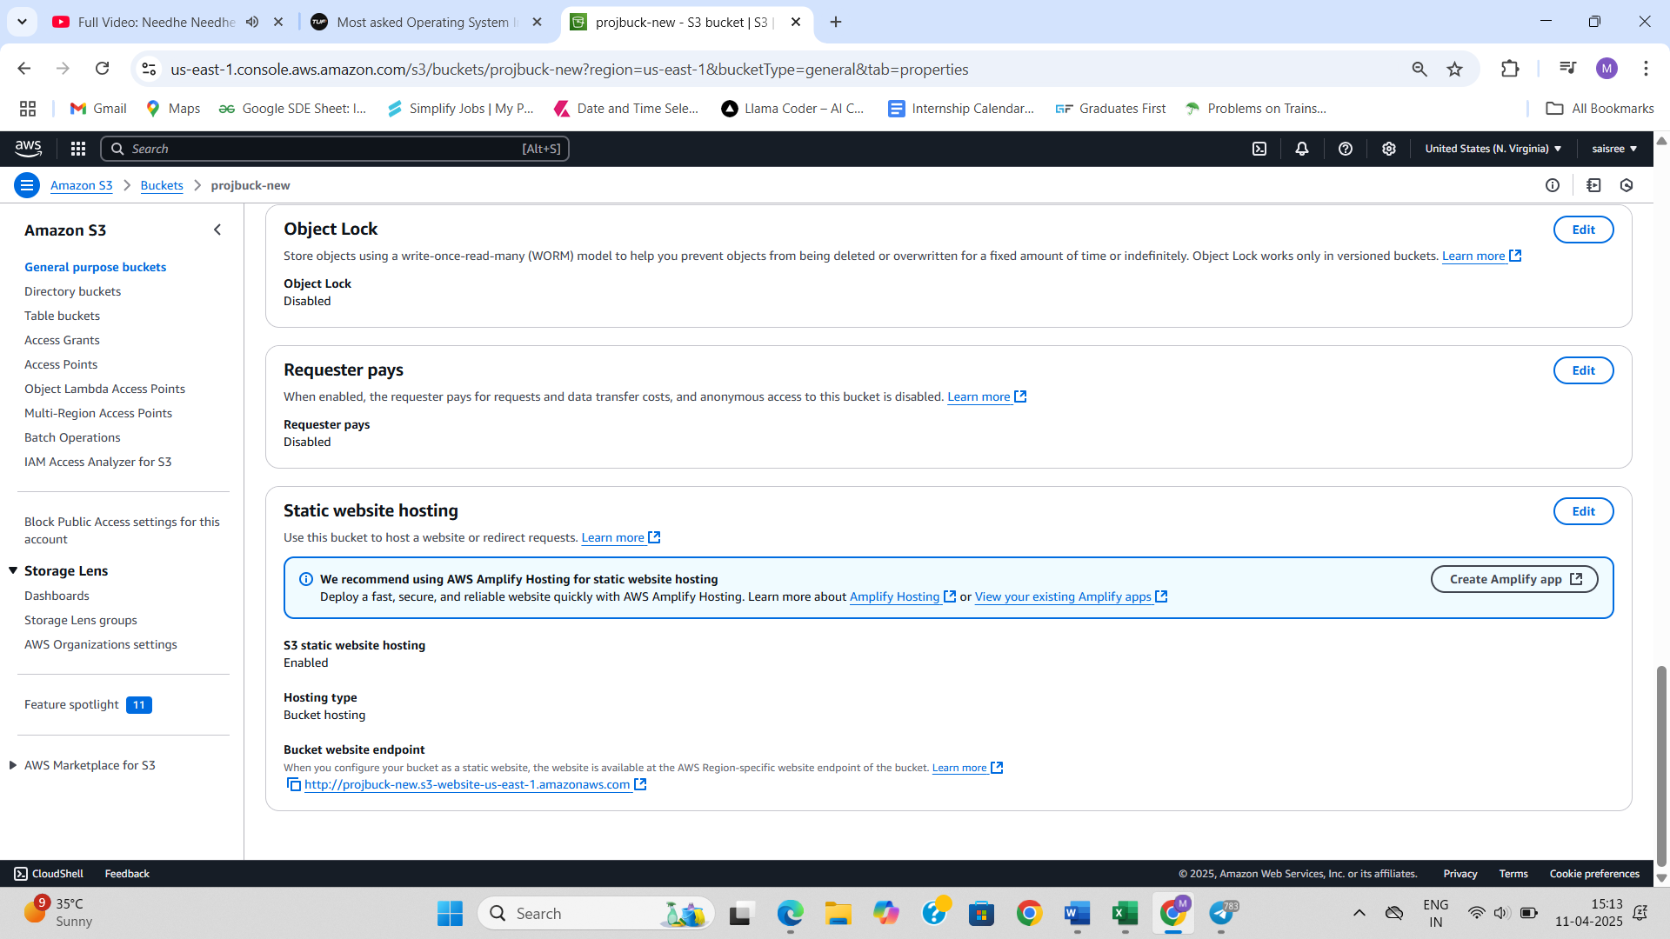
STEP 5: ENABLE STATIC WEBSITE HOSTING

Slide 9
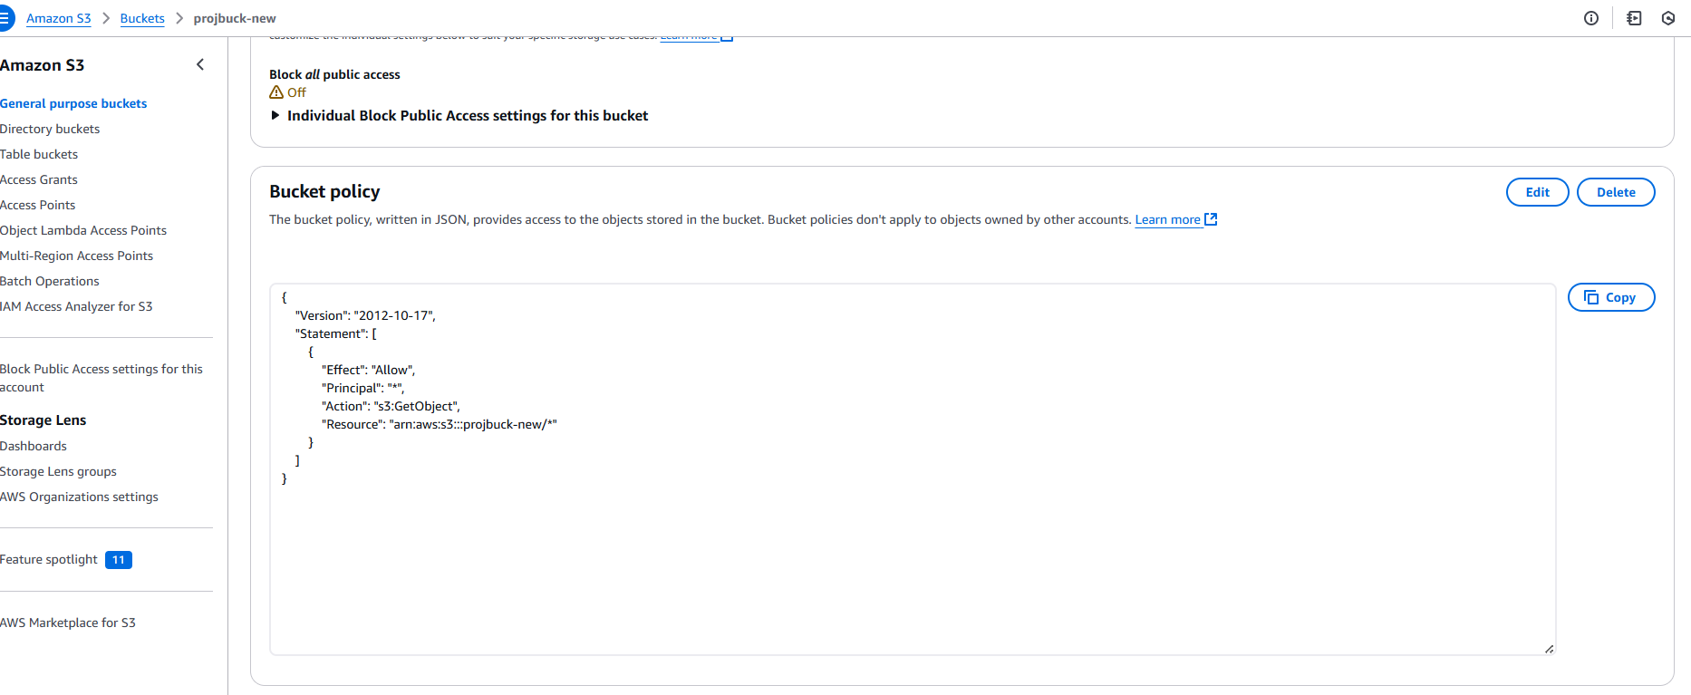
Step 6: write permission configuration

Slide 10
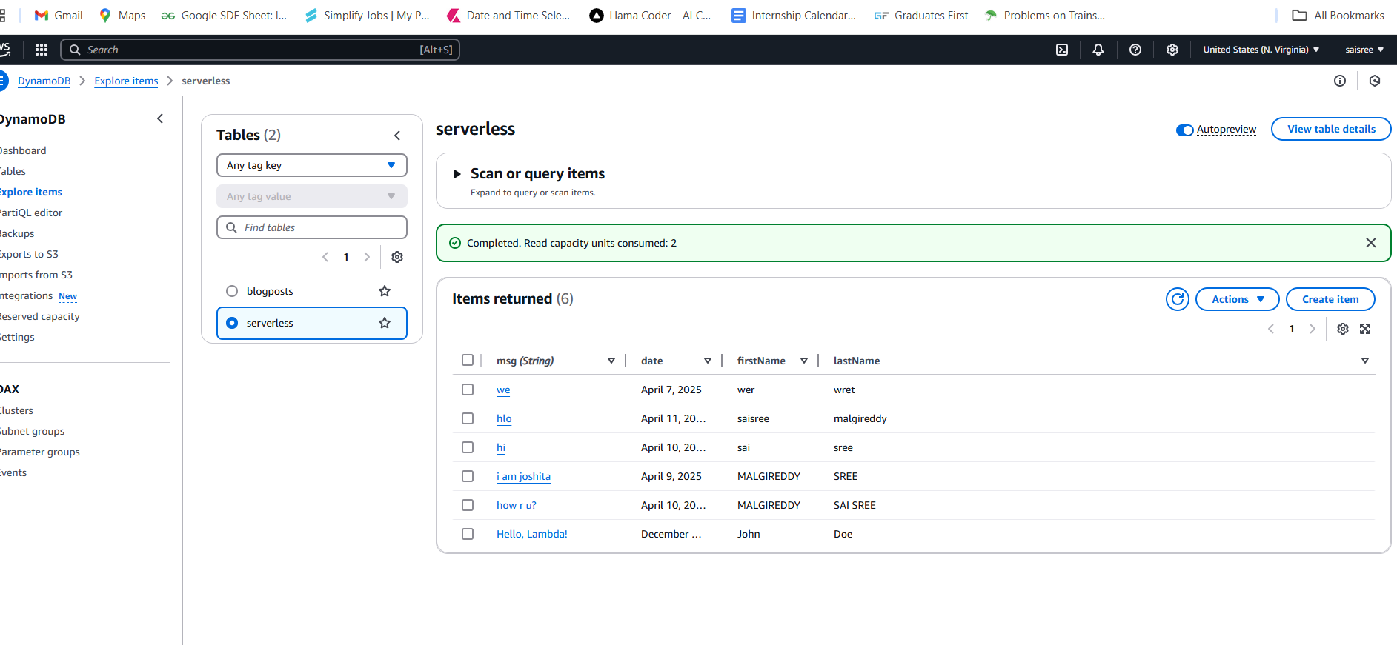
Step 7:Create database table

Slide 11
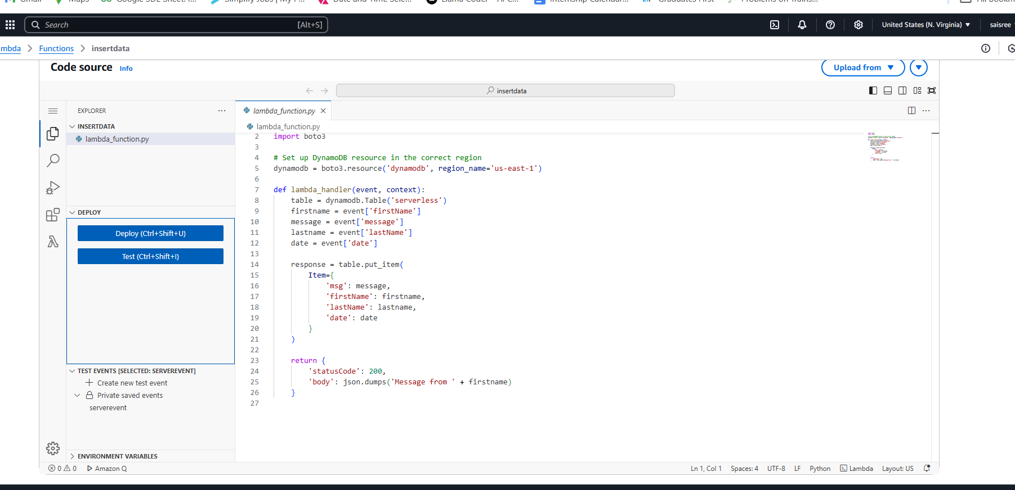
STEP 8: write lambda get and post function

Slide 12
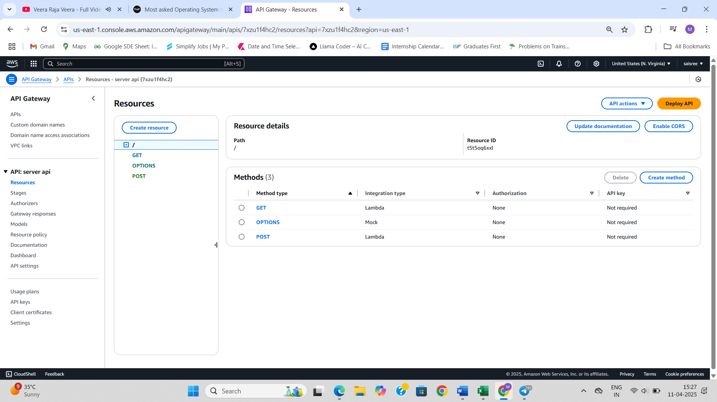
Step 9: Create REST API

Slide 13
Key Features and Functionality
The Serverless Blog Engine allows users to create, read, update, and delete blog posts through a web interface hosted on Amazon S3. User actions trigger API calls via API Gateway, processed by AWS Lambda functions that interact with DynamoDB for data storage. The system is fully integrated with AWS services, offering real-time responsiveness, scalability, and secure operations—all without managing any servers.

Slide 14
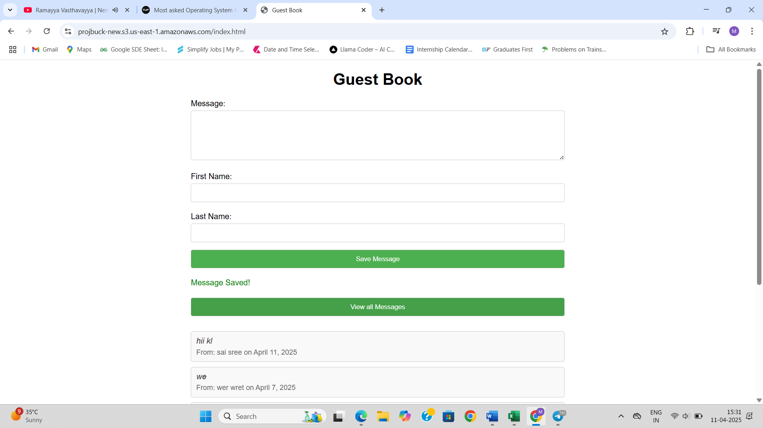
Results and Outputs

Slide 15
Challenges and Solutions
During development, one of the main challenges was managing CORS errors when integrating the frontend with API Gateway. This was resolved by configuring appropriate CORS settings in the API Gateway console. Another issue involved permission errors between services, which was tackled by carefully setting up IAM roles and policies with least-privilege principles. Debugging Lambda functions was streamlined using AWS CloudWatch logs, which helped trace issues and monitor function behavior. Additionally, testing API endpoints with tools like Postman and the AWS CLI proved valuable in identifying and fixing bugs efficiently.

Slide 16
Learnings & Takeaways
This project significantly enhanced my technical skills in AWS services, including IAM for secure access control, Lambda functions for serverless computing, API Gateway for routing, and DynamoDB for NoSQL data management. I also gained hands-on experience with the AWS Console, CLI, and CloudWatch for deployment and debugging. On the soft skills front, I developed stronger project planning abilities, time management, and problem-solving techniques. Collaborating in a team setting helped sharpen my communication and coordination skills, ensuring smooth integration of different project components.

Slide 17
Future Scope
Future enhancements for the Serverless Blog Engine include adding user authentication with Amazon Cognito for personalized content and secure access. Real-time features like live comment updates or WebSocket-based notifications could improve user engagement. For deployment, setting up CI/CD pipelines using AWS CodePipeline or GitHub Actions can streamline updates. From a cost and performance perspective, implementing caching with Amazon CloudFront and optimizing Lambda memory settings can significantly reduce latency and expenses. Additionally, introducing tagging and monitoring with AWS Cost Explorer would support better resource management and scalability.

Slide 18
References
[1] Amazon S3 User Guide: https://docs.aws.amazon.com/AmazonS3/latest/userguide/Welcome.html [2] Amazon DynamoDB Developer Guide: https://docs.aws.amazon.com/amazondynamodb/latest/developerguide/Welcome.html [3] AWS Lambda Developer Guide: https://docs.aws.amazon.com/lambda/latest/dg/welcome.html [4] Amazon API Gateway Developer Guide: https://docs.aws.amazon.com/apigateway/latest/developerguide/welcome.html [5] Hosting a Static Website on Amazon S3: https://docs.aws.amazon.com/AmazonS3/latest/userguide/WebsiteHosting.html [6] Set Up API Gateway with Lambda Integration: https://docs.aws.amazon.com/apigateway/latest/developerguide/apigateway-getting-started-with-rest-apis.html [7] Best Practices for DynamoDB: https://docs.aws.amazon.com/amazondynamodb/latest/developerguide/best-practices.html

Slide 19
THANK YOU

